Slide 1


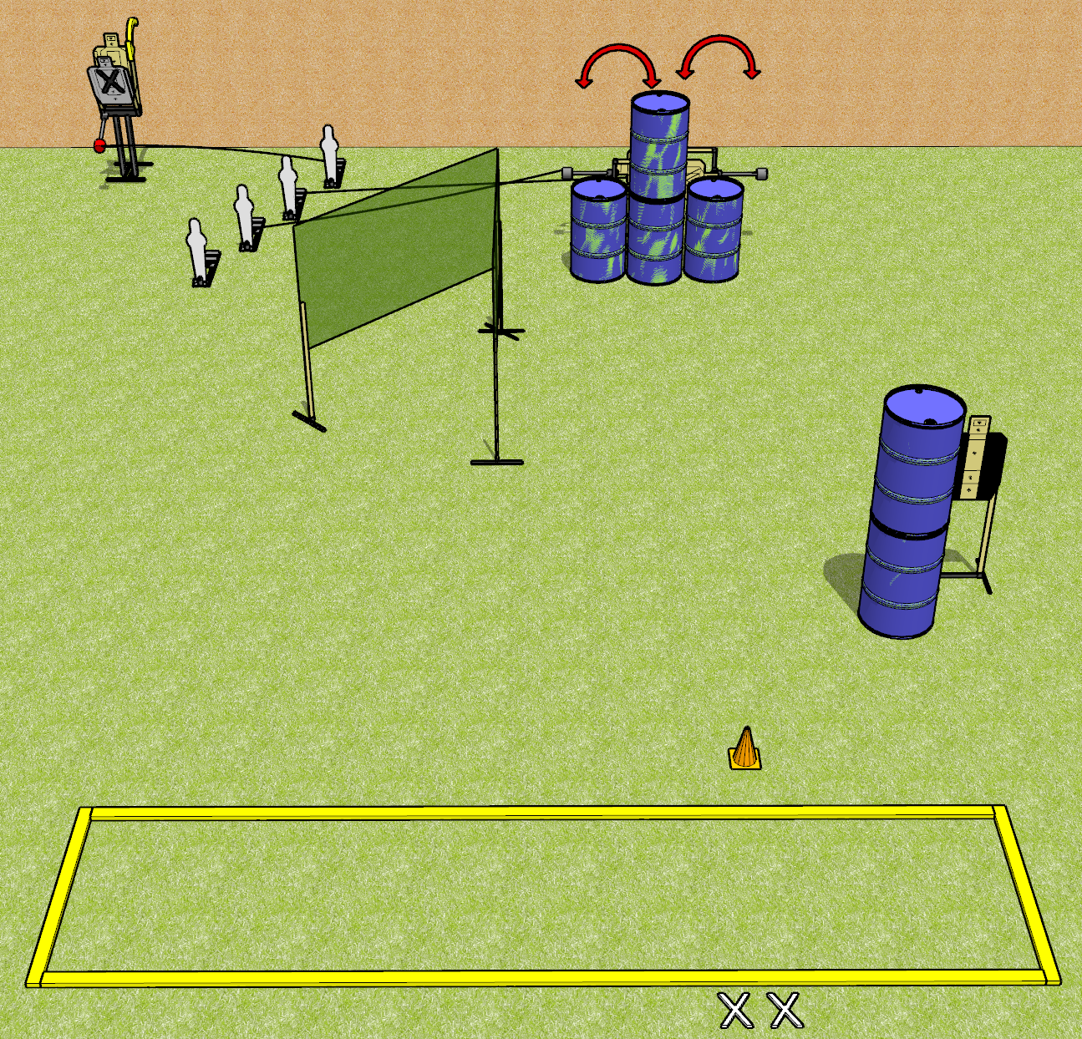
 | Dothan Gun Club – USPSA Match Speed Shoot with Extra Steps Course Designer : Drew Coleman
START POSITION : Standing with both feet on X’s, wrists above shoulders
GUN READY CONDITION : Pistol loaded and holstered. PCC loaded, held with both hands, buttstock on belt, safety on, pointed at orange cone. |  | SCORING: Comstock, 12 rounds TARGETS: 5 paper, 4 Steel SCORED HITS: Best 2 on paper, steel until down START-STOP: Audible, last shot RULES: swingers/max trap must be activated before being engaged. Max trap is disappearing
STAGE PROCEDURE: Engage targets as they become available from within the fault lines.

Slide 2
Speed Shoot With Extra Steps
Written Stage Briefing
Speed Shoot With Extra Steps is a 12 round, 60 point, Comstock short course. There are four USPSA targets and four mini poppers. The best two hits on paper will score, and steel must fall to score. The start signal is audible.
Mini poppers are designated MP1-4. MP2 activates the left swinger and MP2 activates the right swinger. MP4, at the back, activates the max trap. The swingers must be activated before they can be engaged. The max trap must also be activated before it can be engaged. The max trap is a disappearing target. Please check all the activators before walk through, and set them the same way every time.
Handgun start position is standing with both feet on X’s, wrists above shoulders. Handgun is loaded and holstered.
PCC start position is standing with both feet on X’s, muzzle pointed generally at cone. Loaded carbine is held with both hands, buttstock on belt, safety on.
On start signal, engage targets as they become available from within the fault lines.

